Slide 1
SPARSE MATRICES

Slide 2
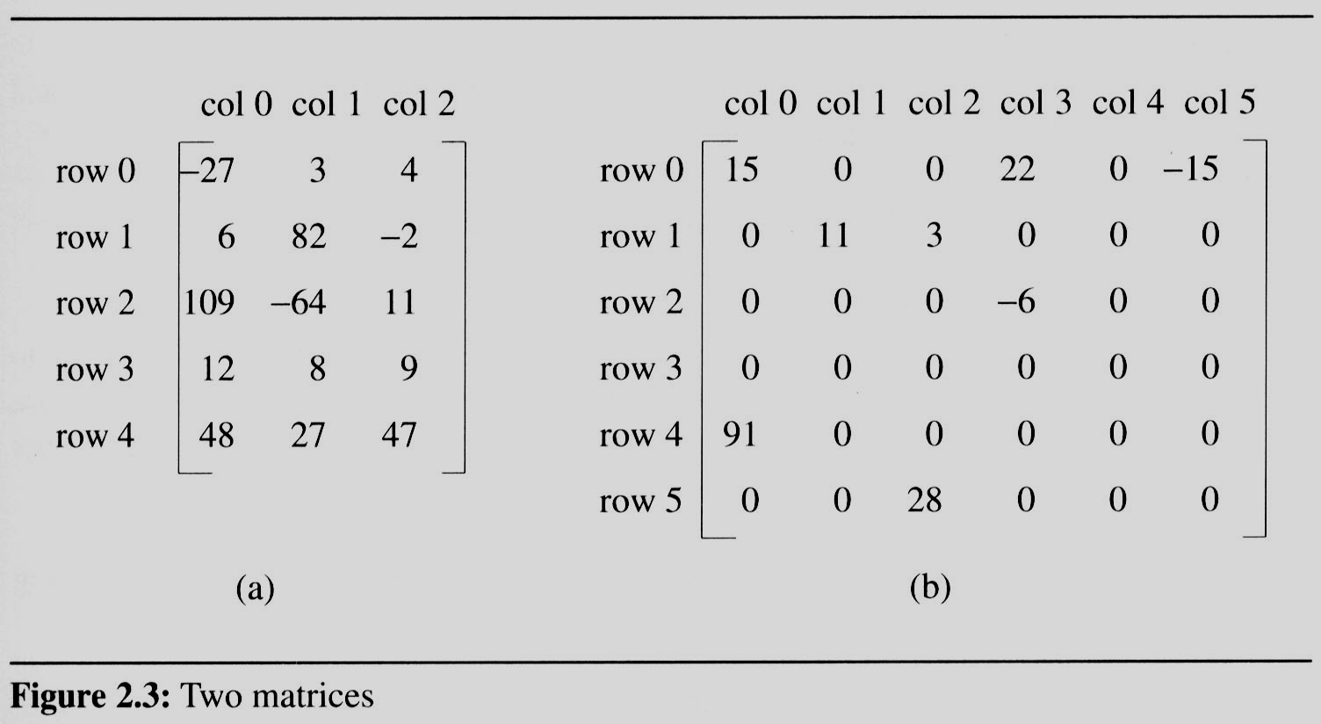
Sparse Matrix
In mathematics, a matrix contains m rows and n columns of elements, we write mxn to designate a matrix with m rows and n columns.
A sparse matrix is a matrix that is comprised of mostly zero values
sparse matrix
data structure?
5*3
15/15
6*6
8/36

Slide 3
Sparse Matrix
The standard representation of a matrix is a two-dimensional array defined as
A[max_rows][max_cols]
- We can locate quickly any element by writing a[i][j].
Sparse Matrix wastes space
- Need for alternative form of representation
- Representation of sparse matrix must store only the nonzero elements.
- Each element is characterized by <row, col, val>
Class creation:
class SM
{
int row, col, val;
};
SM a[max_terms];

Slide 4
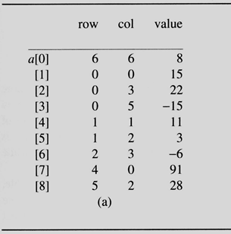
Reading and representing Sparse matrix in array of objects format

Slide 5
Reading and representing Sparse matrix in array of objects format

Slide 6
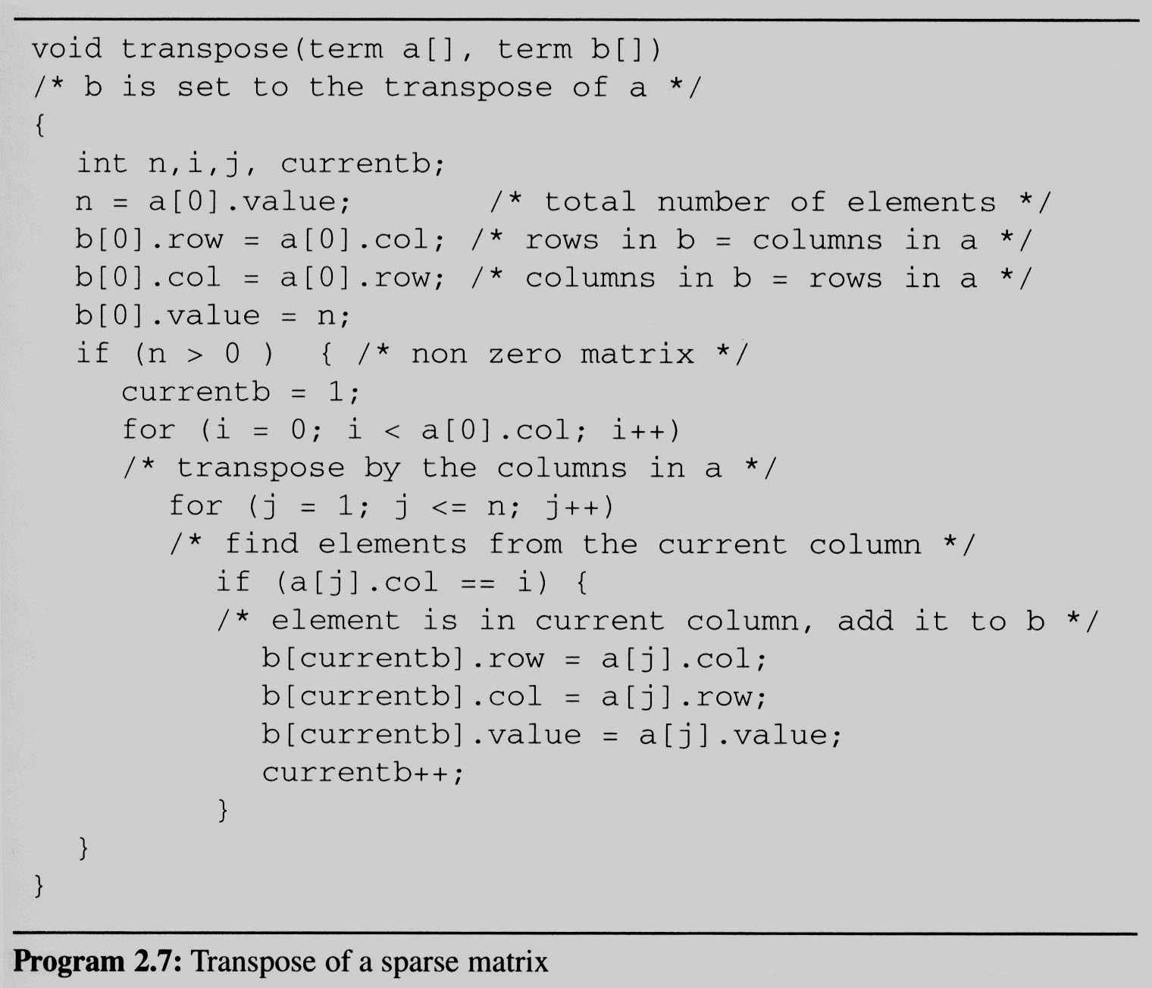
Transpose of Sparse Matrix
Assign
A[i][j] to B[j][i]
place element <i, j, value> in element <j, i, value>
For all columns i
For all elements in column j
Scan the array “columns” times.
The array has “elements” elements.
==> O(columns*elements)

Slide 7
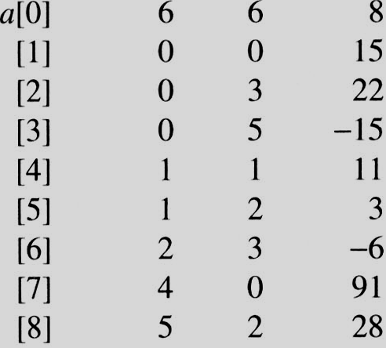
i=0 j=1
i=0 j=1
a[j]= 0 == i
i=0 j=2
i=0 j=2
a[j]=3 != i
i=0 j=3
i=0 j=3
a[j] = 5 != i
i=0 j=4
i=0 j=4
a[j].col = 1 a[j].col != i
i=0 j=5
i=0 j=5
a[j].col = 2 a[j].col != i
i=0 j=6
i=0 j=6
a[j].col = 3 != i
i=0 j=7
i=0 j=7
a[j].col = 0 == i
i=0 j=8
i=0 j=8
a[j].col = 2 != i
i=1 j=1
i=1 j=1
a[j].col = 0 != i
i=1 j=2
i=1 j=2
a[j].col = 3 != i
i=1 j=3
i=1 j=3
a[j].col = 5 != i
i=1 j=4
i=1 j=4
a[j].col = 1 == i
i=1 j=5
i=1 j=5
a[i].col = 2 != i
i=1 j=6
i=1 j=6
a[j].col = 3 != i
i=1 j=7
i=1 j=7
a[j] = 0 != i
i=1 j=8
EX: A[6][6] transpose to B[6][6]
i=1 j=8
a[i].col = 2 != i
Matrix A
Row Col Value
Set Up row & column in B[6][6]
Row Col Value
0 6 6 8
1 0 0 15
2 0 4 91
3 1 1 11
And So on…

Slide 8
Transpose of a Sparse matrix
Discussion: compared with 2D array representation
O(columns * elements) vs O(columns * rows)
elements => columns * rows when non-sparse which is equivalent to O( columns² * rows)
Problem: Scan the array “column” times
In fact, we can transpose a matrix represented as a sequence of triplets in O (columns + elements) time.
Solution:
First, determine the number of elements in each column of the original matrix.
Second, determine the starting positions of each row in the transpose matrix.

Slide 9
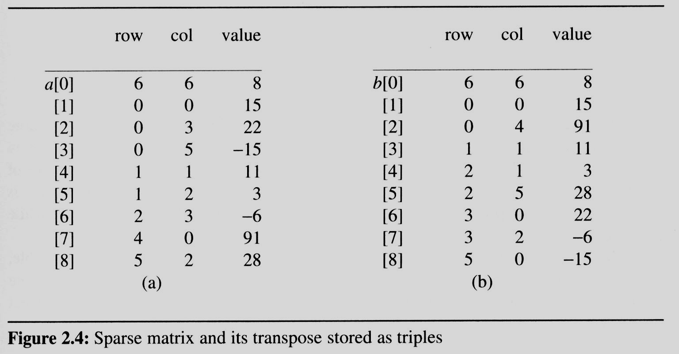
Fast Transpose of a Sparse matrix
[0] [1] [2] [3] [4] [5] row_terms = 2 1 2 2 0 1 starting_pos = 1 3 4 6 8 8
transpose

Slide 10
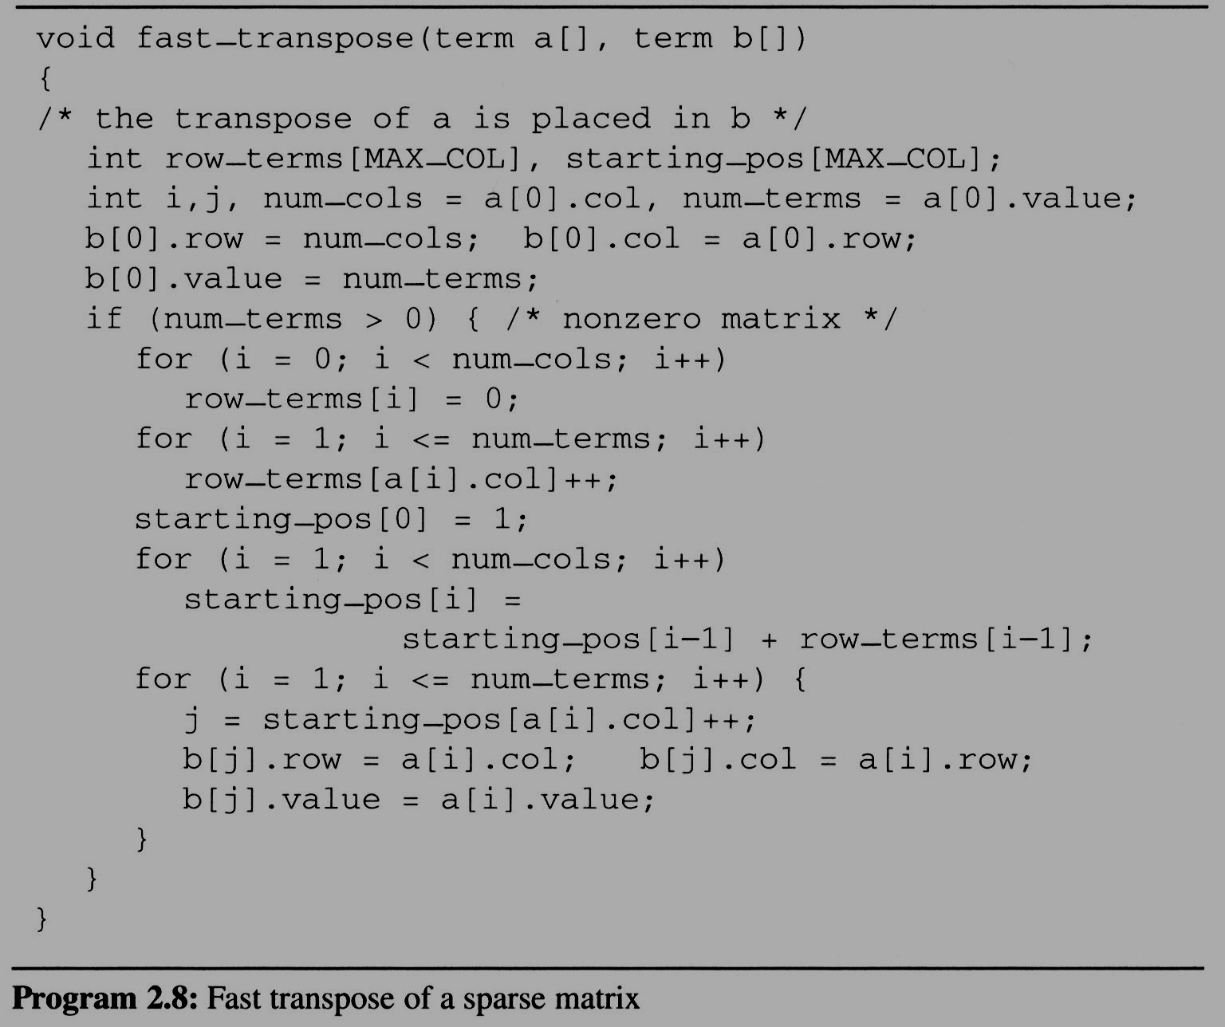
1
0
2
1
0
1
0
1
2
0
0
0
1
Matrix A
Row Col Value
1
3
4
6
8
8

Slide 11
[0] [1] [2] [3] [4] [5] row_terms = 2 1 2 2 0 1 starting_pos = 1 3 4 6 8 8
[0] [1] [2] [3] [4] [5] row_terms = 2 1 2 2 0 1 starting_pos = 2 3 4 6 8 8
[0] [1] [2] [3] [4] [5] row_terms = 2 1 2 2 0 1 starting_pos = 2 3 4 7 8 8
[0] [1] [2] [3] [4] [5] row_terms = 2 1 2 2 0 1 starting_pos = 2 3 4 7 8 9
[0] [1] [2] [3] [4] [5] row_terms = 2 1 2 2 0 1 starting_pos = 2 4 4 7 8 9
[0] [1] [2] [3] [4] [5] row_terms = 2 1 2 2 0 1 starting_pos = 2 4 5 7 8 9
[0] [1] [2] [3] [4] [5] row_terms = 2 1 2 2 0 1 starting_pos = 2 4 5 8 8 9
[0] [1] [2] [3] [4] [5] row_terms = 2 1 2 2 0 1 starting_pos = 3 4 5 8 8 9
[0] [1] [2] [3] [4] [5] row_terms = 2 1 2 2 0 1 starting_pos = 3 4 6 8 8 9
I = 1
I = 2
I = 3
I = 4
I = 5
I = 6
I = 7
Matrix A
Row Col Value
Row Col Value
0 6 6 8
1 0 0 15
2 0 4 91
3 1 1 11
4 2 1 3
5 2 5 28
6 3 0 22
7 3 2 -6
8 5 0 -15

